Slide 1
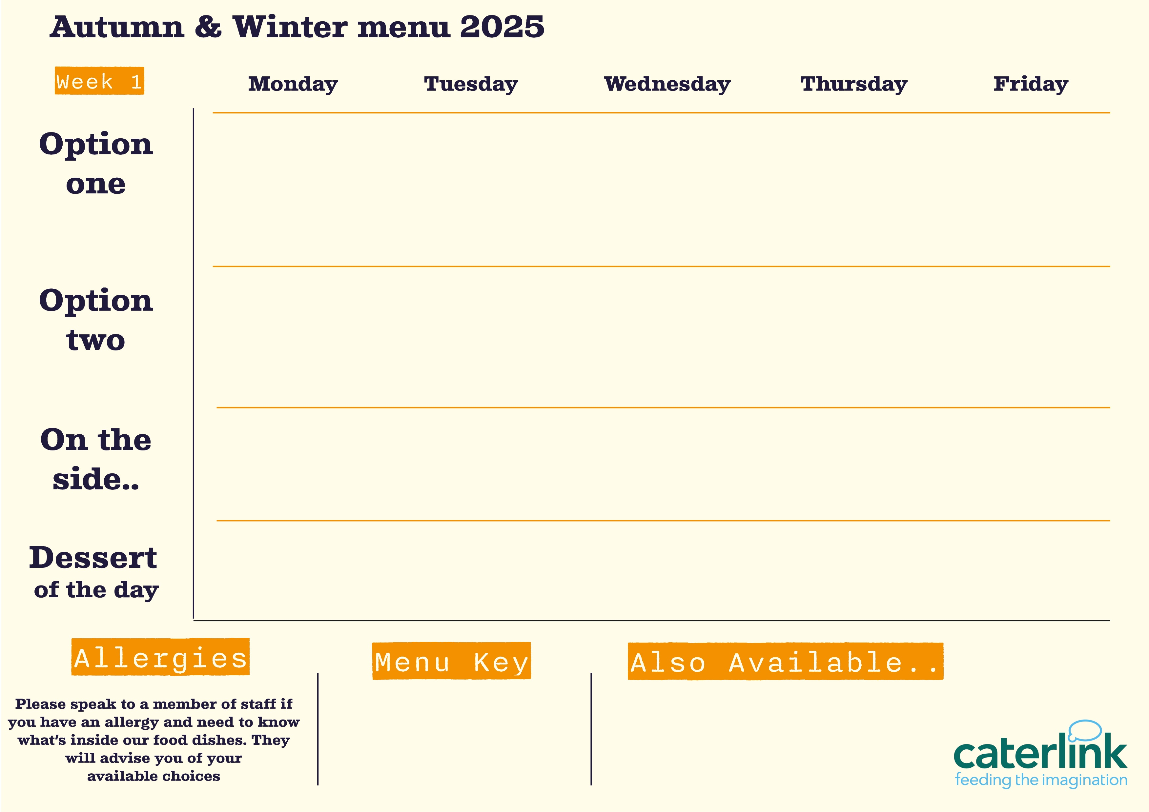




Classic Beef bolognaise
with garlic bread
Mexican Beef chilli
with 50/50 rice or soft taco
Peri-Peri
chicken
with roast potatoes & gravy
Green Thai chicken curry
with 50/50
rice
Fish fingers or salmon
fishcake
with chips
Mexican vegetable rice
Cajun sweet potato tart
with roast potatoes & gravy
Sticky soy & honey noodles
Loaded
hound dog
with chips
Autumn vegetable risotto
with garlic bread
Green Beans
Carrots
Pineapple Salsa & Slaw
Cauliflower
Peas
Sweetcorn
Roasted Broccoli
Baked Beans
Coleslaw
Pineapple upside down cake
With custard
Oaty cookie
Plum & vanilla crumble
With custard
School cake
Lemon drizzle sponge
Vegan option
Our hot and cold grab & go selection alongside soup of the day and filled jacket potatoes
Added plant protein
Source of wholemeal

Slide 2


Macaroni Cheese
with crunchy garlic croutons
Butchers Sausage & Mash
with onion gravy
Hot Wok chicken Noodles
with 50/50
rice
Battered fillet of fish
with chips & tartare sauce
Spicy Chicken
with khobez and tabbouleh salad
Quorn & Black bean Fajitas
with rice
Houmous & Falafel
with khobez and tabbouleh salad
Veggie Sausage & Mash
with onion gravy
Black bean Vegetables
with rice
Greek spinach & filo parcels
with chips
Roasted butternut squash
Cauliflower
Red cabbage slaw
Roasted chickpea salad
Broccoli
Sweetcorn
Carrots
Green beans
Baked Beans
Garden Peas
Blondie with berries
Syrup Sponge
With custard
Apple & Cherry Oaty Crumble
With custard
Chocolate Shortbread Cake
Pear Upside Down cake
Vegan option
Our hot and cold grab & go selection alongside soup of the day and filled jacket potatoes
Added plant protein
Source of wholemeal

Slide 3

Vegetarian Thai Noodles
Meatballs in Tomato Sauce
with spaghetti
The Classic Roast Dinner
with all the trimmings
Battered fillet of fish
with chips & tartare sauce
Chicken Korma
with 50/50
rice
Roast
Quorn
with all the trimmings
Sweet potato, chickpea & spinach tikka
with 50/50
rice
Vegan Meatball Pasta Bake
Vegetable Biryani
The Big Plant Burger
with chips
Green beans
Sweetcorn
Broccoli
Roasted Vegetables
Roasted carrots
Red cabbage
Roasted Cauliflower & Sambals
Baked Beans
Garden Peas
Warm Banana Flapjack
Vanilla sponge
Jam Sponge
With custard
Sticky Toffee Apple Crumble
With custard
Berry Crumble cake
Vegan option
Our hot and cold grab & go selection alongside soup of the day and filled jacket potatoes
Added plant protein
Source of wholemeal

